Slide 1
Deep Learning: RNNs
Recurrent Neural Networks
Notes:
Welcome students to the topic of Deep Learning, specifically focusing on Recurrent Neural Networks. Ask students if they have any prior knowledge of neural networks or deep learning. Provide a brief overview of what will be covered in the presentation.

Slide 2
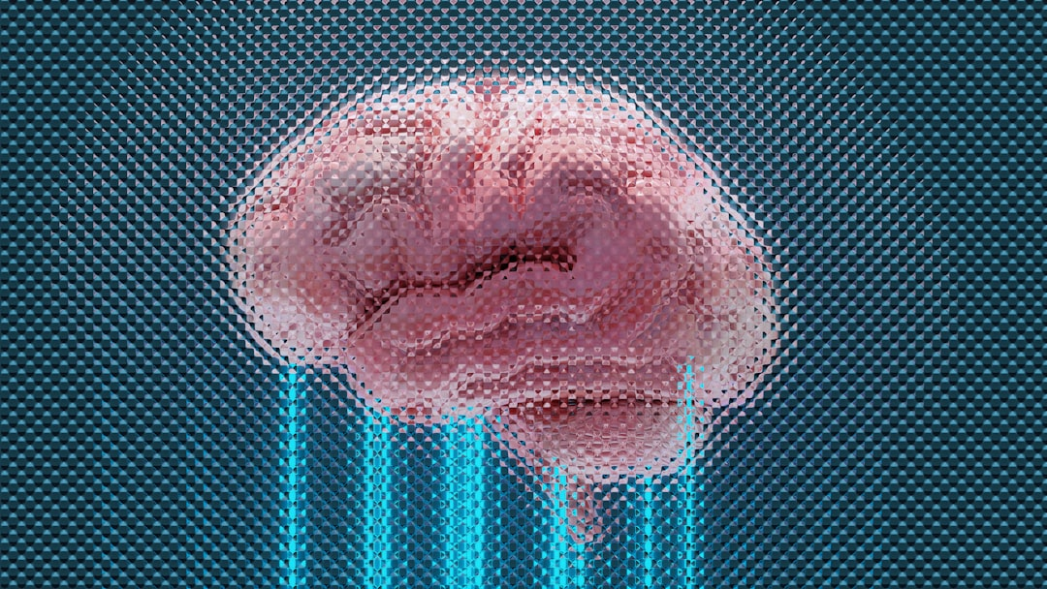
Introduction to RNNs
RNNs handle sequential data
Used in language modeling and speech recognition
Can learn patterns in time series data
Effective for predicting future values
Can be trained using backpropagation
RNNs have feedback connections
Allowing information to loop back
Enabling the network to keep track of state
Over time, RNNs can learn complex patterns
Notes:
Explain that RNNs are designed to handle sequential data, such as speech or text. Provide examples of how RNNs are used in real-world applications, like language translation or speech recognition. Ask students to consider how RNNs could be used in their own projects or interests.

Slide 3
Architecture

Slide 4
Variants and Equations
Simple RNNs: basic architecture
LSTMs: long short-term memory
GRUs: gated recurrent units
Bidirectional RNNs: handle both past and future
Equation: y_t = sigmoid(W*x_t + U*h_(t-1))
LSTMs use memory cells for better performance
GRUs use gates for better performance
Both LSTMs and GRUs reduce vanishing gradients
Notes:
Discuss the different variants of RNNs, including LSTMs and GRUs. Explain how these variants address the vanishing gradient problem. Provide examples of when to use each type of RNN. Ask students to consider how the different architectures could be applied to their own projects.

Slide 5
Applications and Advantages/Limitations
Language modeling and translation
Speech recognition and synthesis
Time series forecasting and prediction
Advantage: handle sequential data
Limitation: can be computationally expensive
Advantage: can learn complex patterns
Limitation: can suffer from vanishing gradients
Used in many real-world applications
Including chatbots and virtual assistants
Notes:
Explain the various applications of RNNs, including language modeling and speech recognition. Discuss the advantages and limitations of RNNs, such as their ability to handle sequential data and their potential for computational expense. Ask students to consider how RNNs could be used in their own projects or interests. Provide examples of real-world applications that use RNNs.

Slide 6
Summary
RNNs handle sequential data
Simple RNNs: basic architecture
Language modeling and translation
Notes:
Summarize the key points of the presentation, including the basics of RNNs, their variants, and their applications. Ask students to reflect on what they have learned and how they can apply it to their own projects or interests. Provide final thoughts on the importance of RNNs in deep learning and their potential for future development.

